Slide 1
X Education - Lead Scoring Case Study
Identification of Hot Leads to focus more on them and thus enhancing the conversion ratio for X Education
- Jhanvi Pathak

Slide 2
BACKGROUND(X Education Company)
X Education , An education company named sells online courses to industry professionals
Many interested professionals land on their website
The company markets its courses on several websites like Google. Once these people land on the website, they might browse the courses or fill up a form for the course or watch some videos

Slide 3
CONTI..
When these people fill up a form providing their email address or phone number, they are classified to be a lead
Once these leads are acquired, employees from the sales team start making calls, writing emails, etc. Through this process, some of the leads get converted while most do not
The typical lead conversion rate at X education is around 30%

Slide 4
PROBLEM STATEMENT (X Education Company’s Problem)
X Education gets a lot of leads but its lead conversion rate is very poor
To make this process more efficient, the company wishes to identify the most potential leads, also known as ‘Hot Leads’
If they successfully identify this set of leads, the lead conversion rate should go up as the sales team will now be focusing more on communicating with the potential leads rather than making calls to everyone

Slide 5
PROBLEM STATEMENT (X Education Company’s Problem)
We will help them to select the most promising leads, i.e. the leads that are most likely to convert into paying customers.
We are required to build a model wherein we need to assign a lead score to each of the leads such that the customers with higher lead score have a higher conversion chance
The CEO, in particular, has given a ballpark of the target lead conversion rate to be 80%.

Slide 6
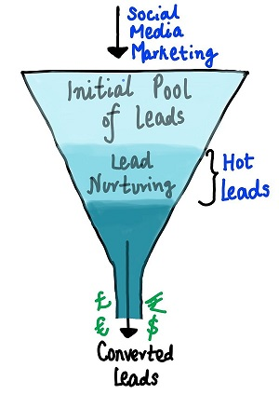
Lead Conversion Process – Demonstrated as a Funnel
A typical lead conversion process can be represented using the following funnel.

Slide 7
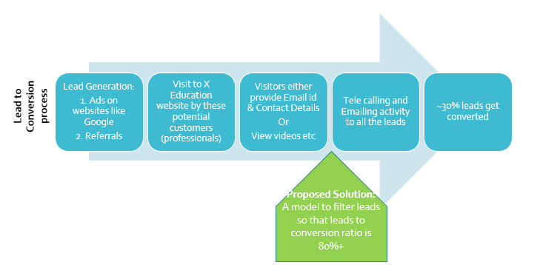
Lead – Conversion Process

Slide 8
PROPOSED SOLUTION
Selection of Hot Leads
Communicating with Hot Leads
Conversion of Hot Leads
Increase conversion
Since we focussed on hot leads, which were more probable to convert, we would have a better conversion rate, and hence we can achieve the 80% target
Leads Clustering
We cluster the leads into certain categories based on their tendency or probability to convert, thus, getting a smaller section of hot leads to focus more on.
Focus Communication
Since we would have a smaller set of leads to have communication with, we might make more impact with effective communication.

Slide 9
SOLUTION (Selection of Hot Leads)
For our Problem Solution, the crucial part is to accurately identify hot leads.
The more accurate we obtain the hot lead, the more chance we get of higher conversion ratio.
Since we have a target of 80% conversion rate, we would want to obtain a high accuracy in obtaining hot leads.

Slide 10
IMPLEMENTATION

Slide 11
Loading & Observing the past data provided by the Company
Univariate, Bivariate, and Heatmap for numerical and categorical columns
Performing pre-requisites for RFE and Logistic Regression
Model Building
Data Gathering
Data Cleaning
Performing EDA
Data Preparation
Duplicate removal, null value treatment, unnecessary column elimination, etc.
Outlier Treatment, Feature-Standardization

Slide 12
Reduction of columns and Model re-building
Selection of top 25 features using RFE
Verifying our Final Model Accuracy etc. with model built with PCA
Feature Selection
Model Building
Model Improvement
Final Model
Verifying with PCA
Model building using RFE for selected columns
Final Model Analysis and performance on Test Data

Slide 13
Plots (Visualization))

Slide 14
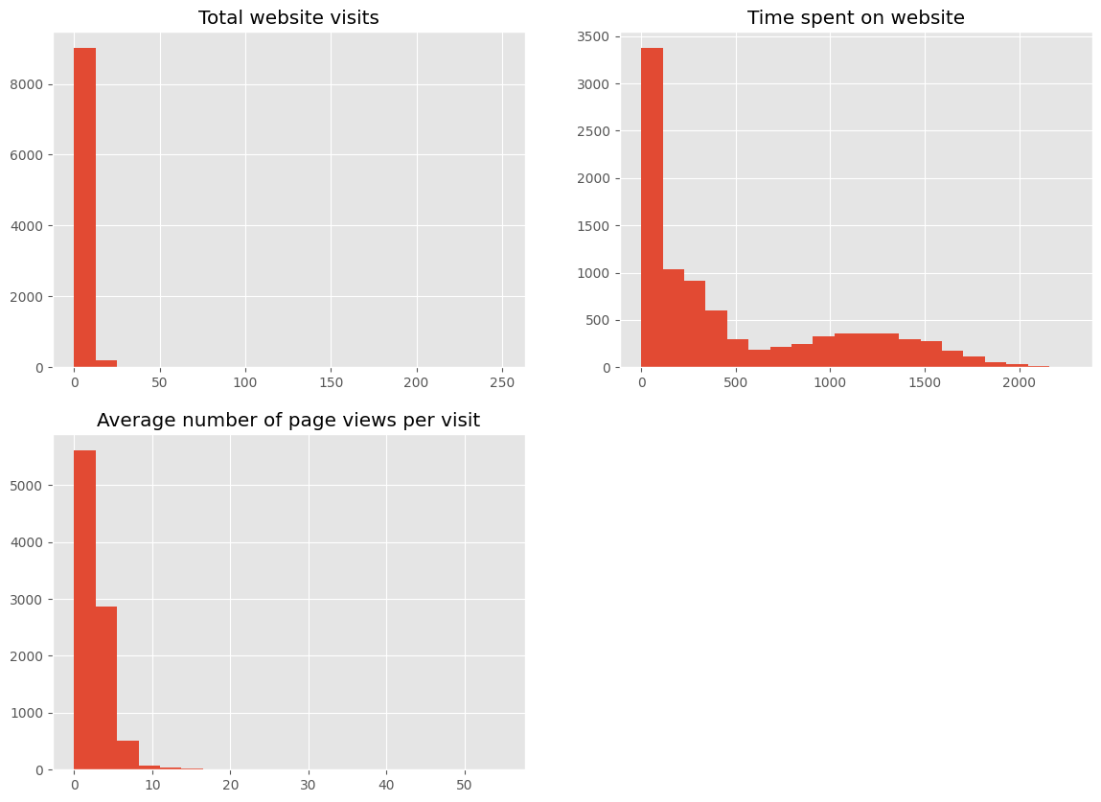
TOTAL WEBSITE VISIT
TIME SPENT ON WEBSITE
AVERAGE NUMBER OG PAGE VIEWS PER VISIT

Slide 15
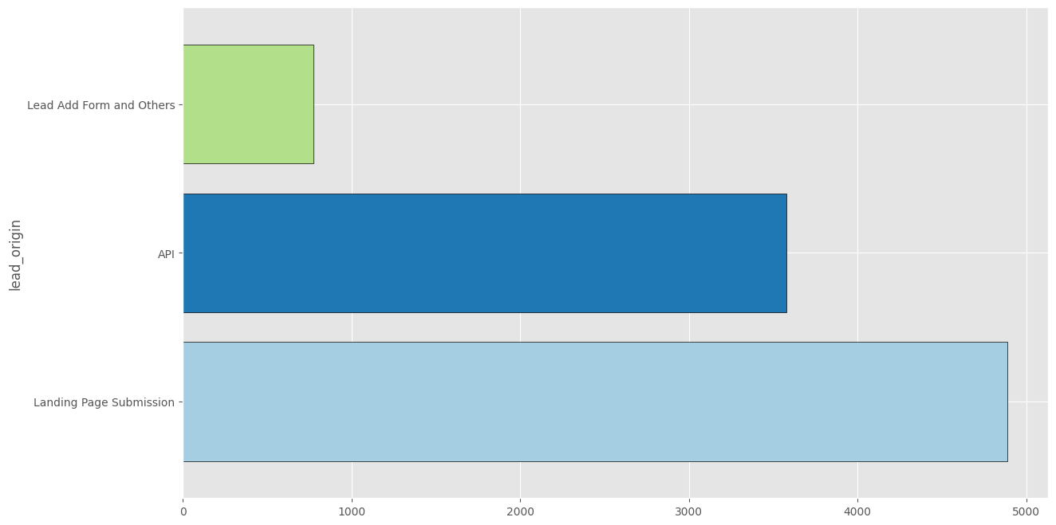
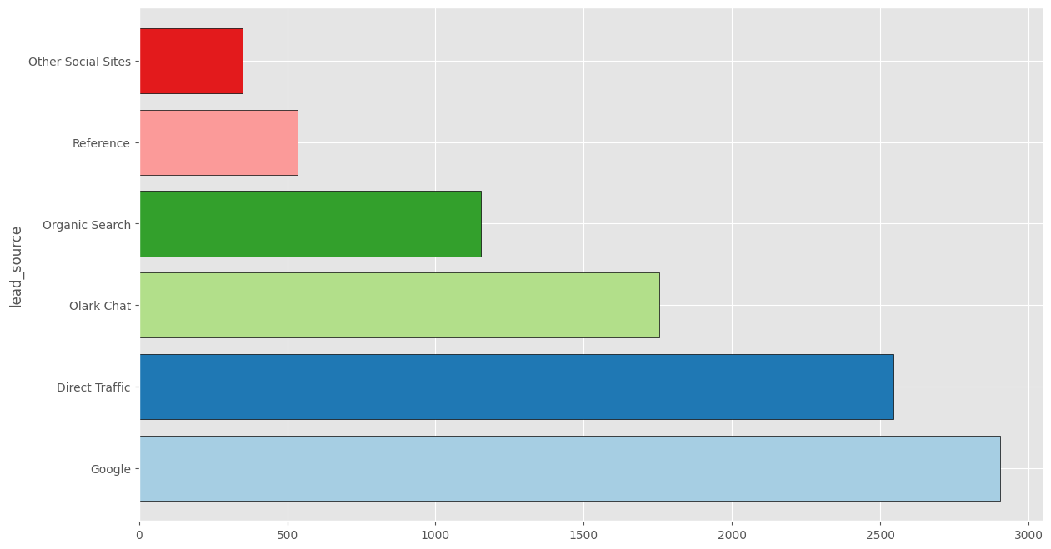
Lead Origin
Lead Source

Slide 16
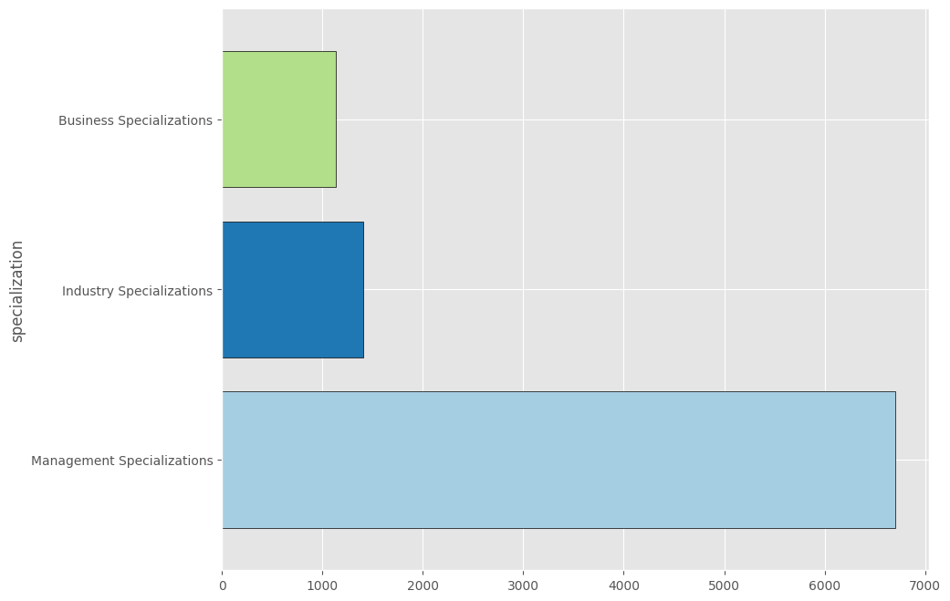
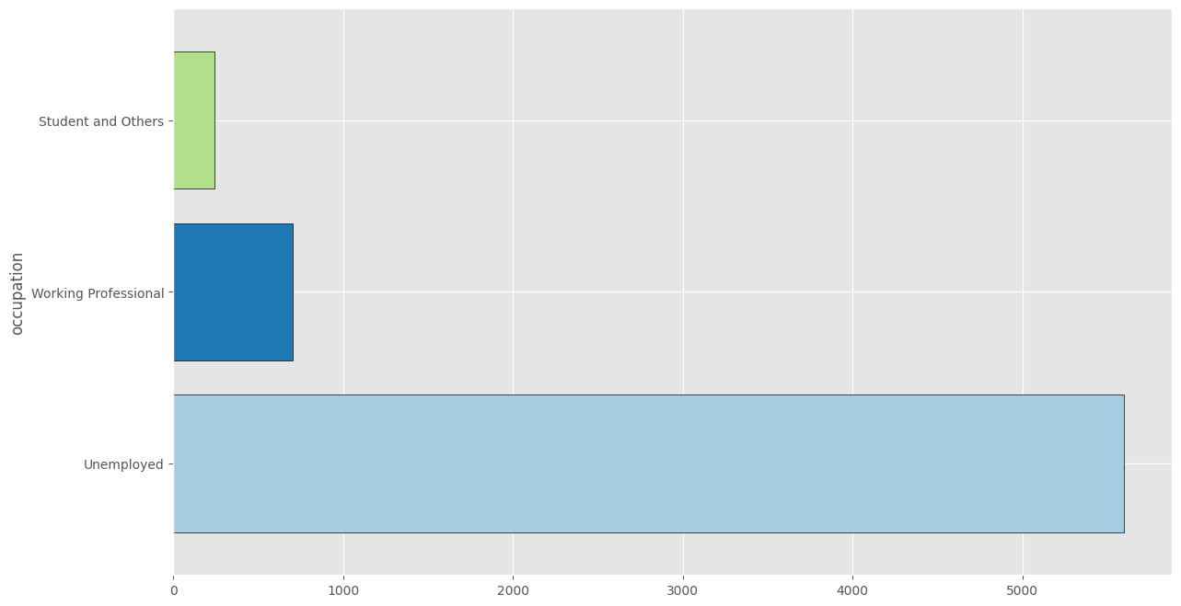
Specialization
Occupation
Unempployed users are the most significant leads

Slide 17
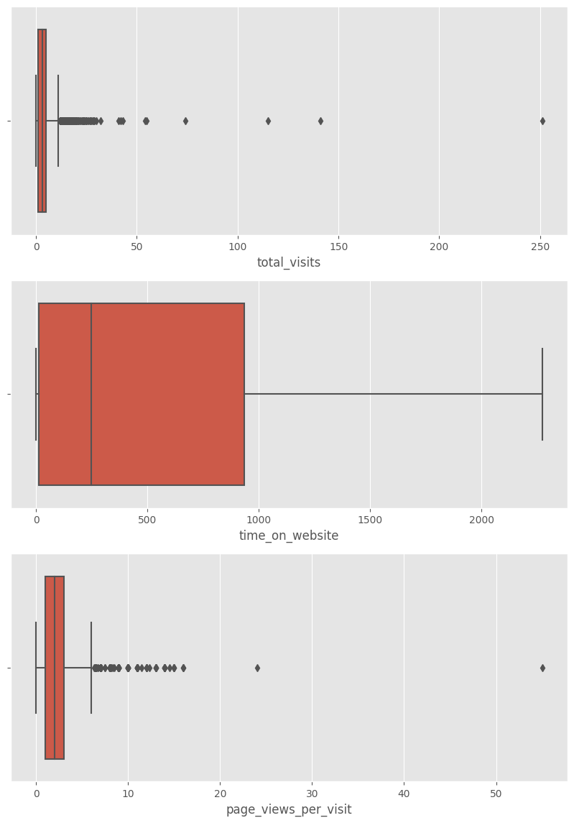
Observations
Looking at both the box plots and the statistics, there are upper bound outliers in both total_visits and page_views_per_visit columns. We can also see that the data can be capped at 99 percentile.

Slide 18
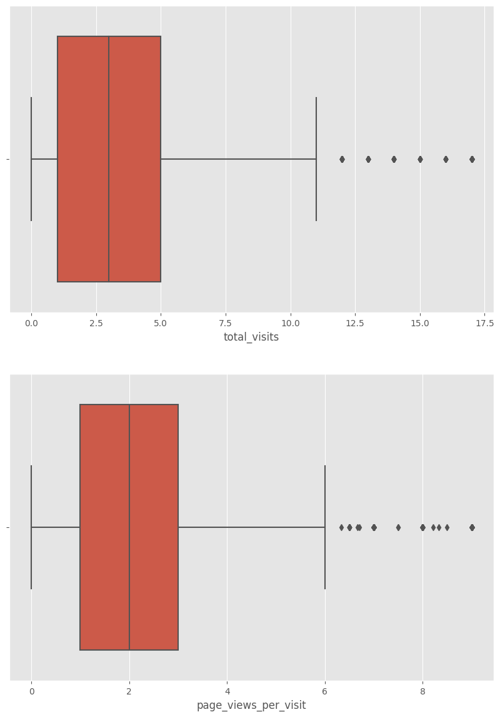
As we can see, we were able to significantly reduce the number of outliers by capping

Slide 19
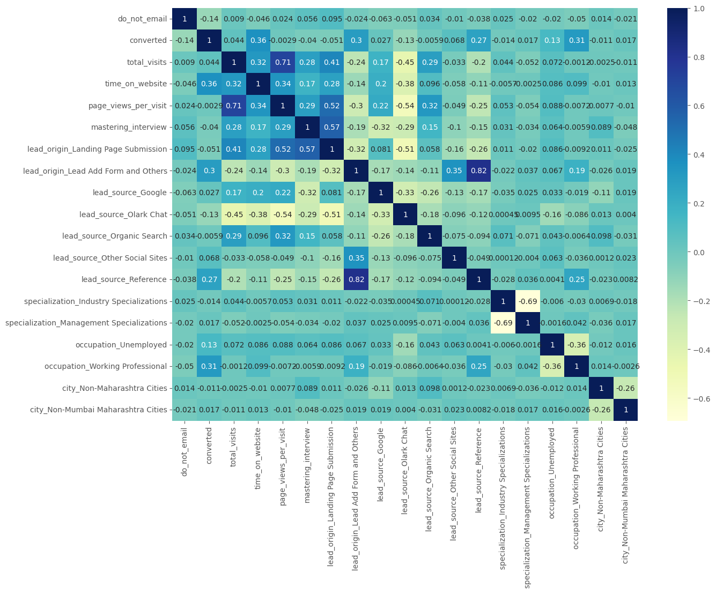
EDA plots depicting correlation (Heat Map) of all selected columns (numerical columns and dummy columns

Slide 20
ACCURACY SENSITIVITY AND SPECIFICITY
80.9%
77.6%
82.9%
PRECISION AND RECALL
73.4% PRECISION
77.6% RECALL

